Slide 1
Big Data Processing Architecture for Smart Farming
Amine Roukh, Fabrice Fote, Sidi Ahmed Mahmoudi, Said Mahmoudi

Slide 2
Content:
Aims and tasks
Methodology
Research
Results
Conclusion

Slide 3
Aims and tasks
Identifying the importance of big data in smart farming and how it can be used to optimize crop growth and resource usage
Analyzing the challenges associated with collecting, storing, and processing large amounts of data in agriculture
Proposing an architecture for processing big data in the context of smart farming, including data collection, storage, processing, machine learning, and visualization
Describing the key components of the proposed architecture and how they can be used to generate insights and recommendations for farmers
Discussing the potential benefits of using a big data processing architecture in smart farming, including increased crop yields and reduced waste.

Slide 4
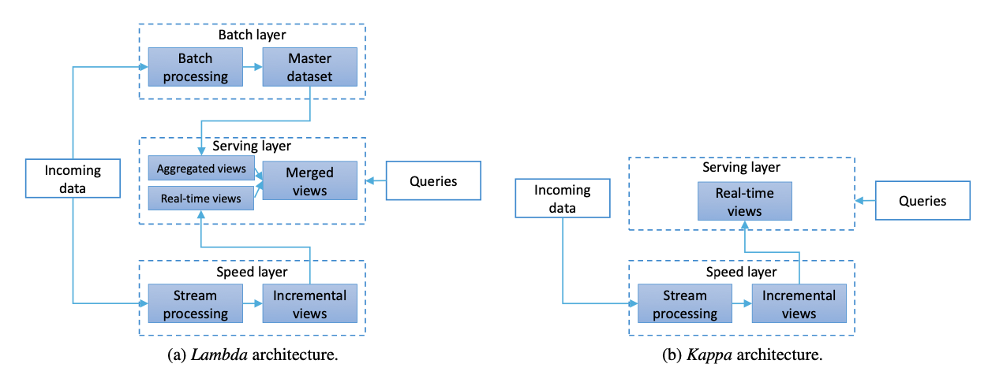
Methodology
Literature review
Survey of existing platforms and solutions
Exploring existing architectures

Slide 5
Research
Master Dataset
Batch Layer
Speed Layer
Serving Layer

Slide 6
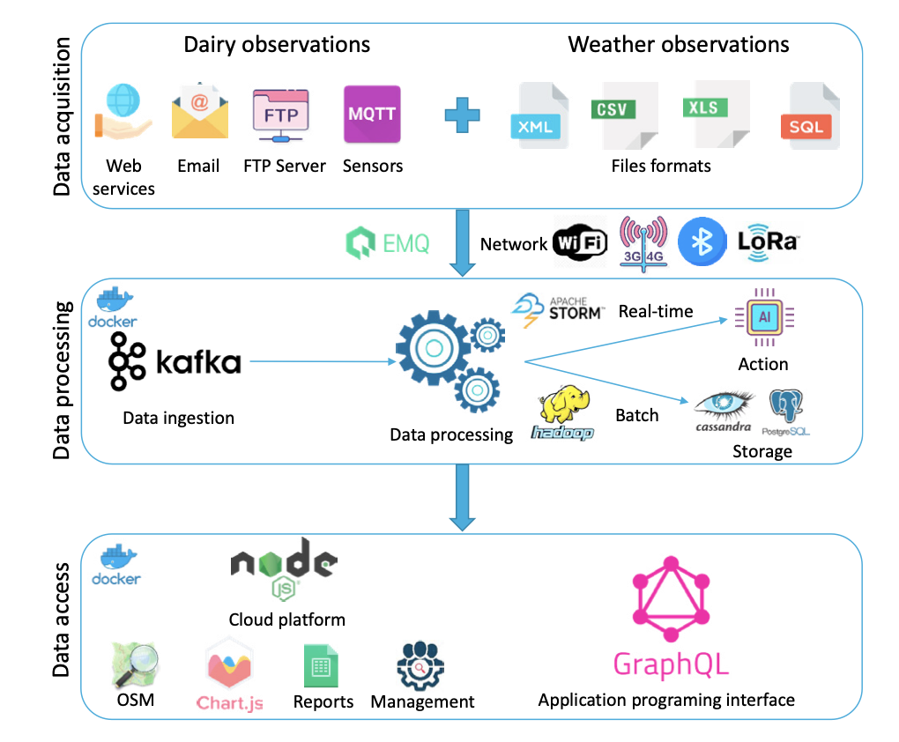
Results

Slide 7
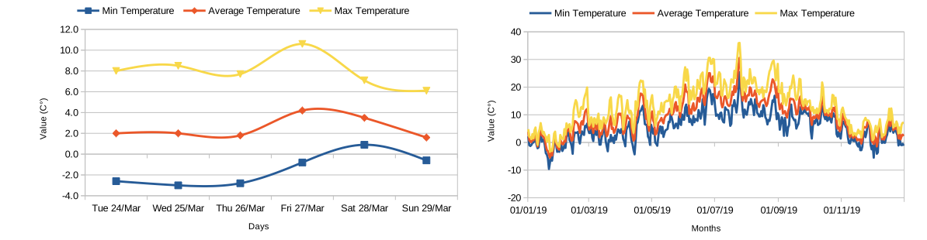
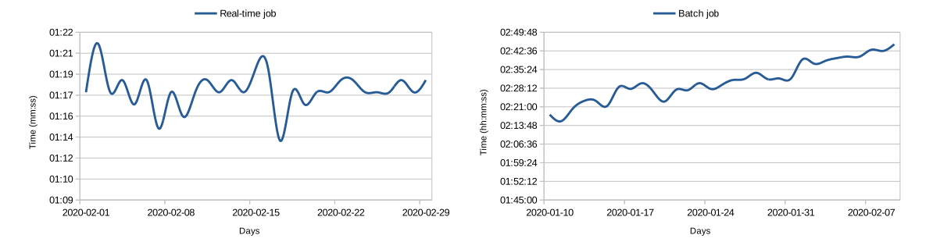
Results

Slide 8
Conclusion
Agriculture is a sector that affects everyone on the planet, and understanding the complex agricultural ecosystems is more important than ever.
Big data generated by emerging agri-tech can provide unique solutions for global challenges and ensure a secure and healthy future.
The authors introduce a cloud-based smart farming management platform called WALLeSMART, which is based on a general big data architecture for smart farming inspired by Lambda architecture.
The platform has been tested with 30 dairy farms and 45 weather stations in Belgium and showed robust data management and user satisfaction.
Future work includes expanding the platform among more farms and improving the user interface with additional features.

